Slide 1
Relevance- and Interface-driven Clustering for Visual Information Retrieval
JAnuary 22, 2020
Reda Bouadjenek, Scott Sanner, Yihao Du

Slide 2
AGENDA
Motivation
Problem definition
Solution Framework
Evaluation
Offline experiment
User experiment
Conclusion

Slide 3
Motivation

Slide 4
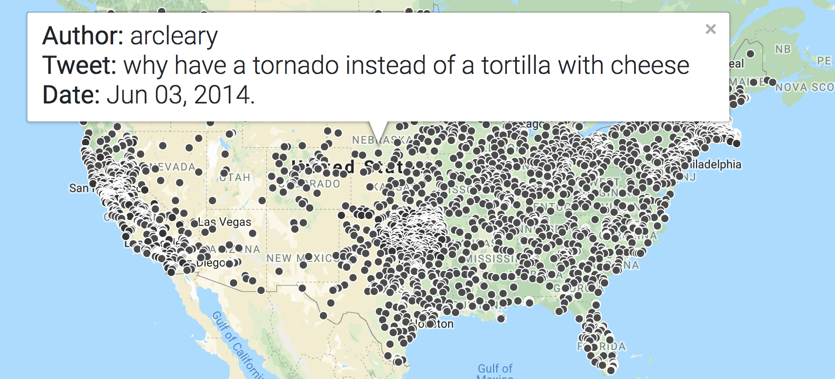
Motivation
Search results of spatio-temporal data are often displayed on a map or other visual interface.
Displaying all results often result in a saturated and unreadable display.
This will prevents users’ investigation.
Solution: Clustering the elements in UI (k-means).
Use case: Searching
Natural Disasters
over Tweets

Slide 5
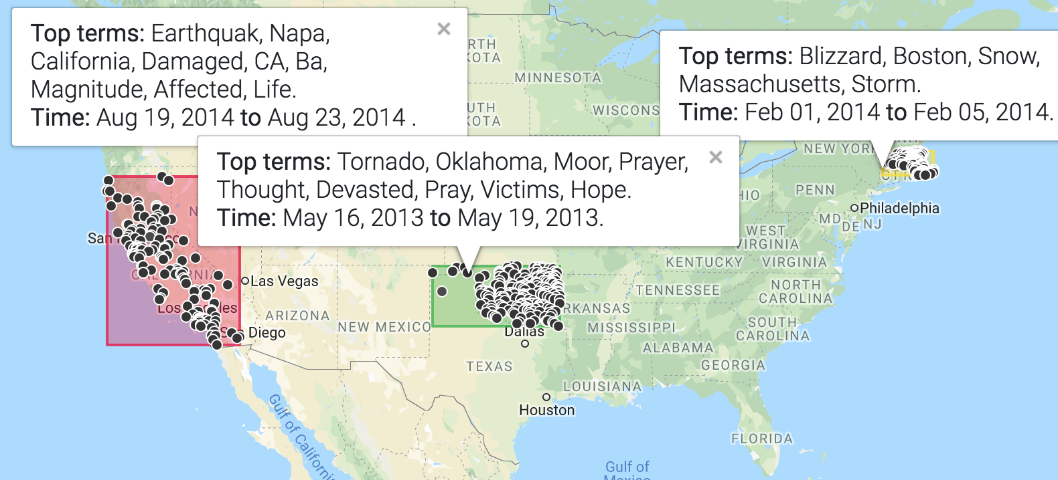
Why Clustering?
Elements in the same cluster behave similarly with respect to information needs – clustering hypothesis.
By checking the cluster’s information, the user can get a clear overview of the elements in the cluster.

Slide 6
What’s wrong with k-means?
k-means doesn’t take into account relevance.
Doesn’t guarantee to have highly relevant clusters.
k-means requires the design of a complex distance metric.
Combining time, location and keyword distances.
Requires tuning
What value of k?
What distance metrics? How to combine them?

Slide 7
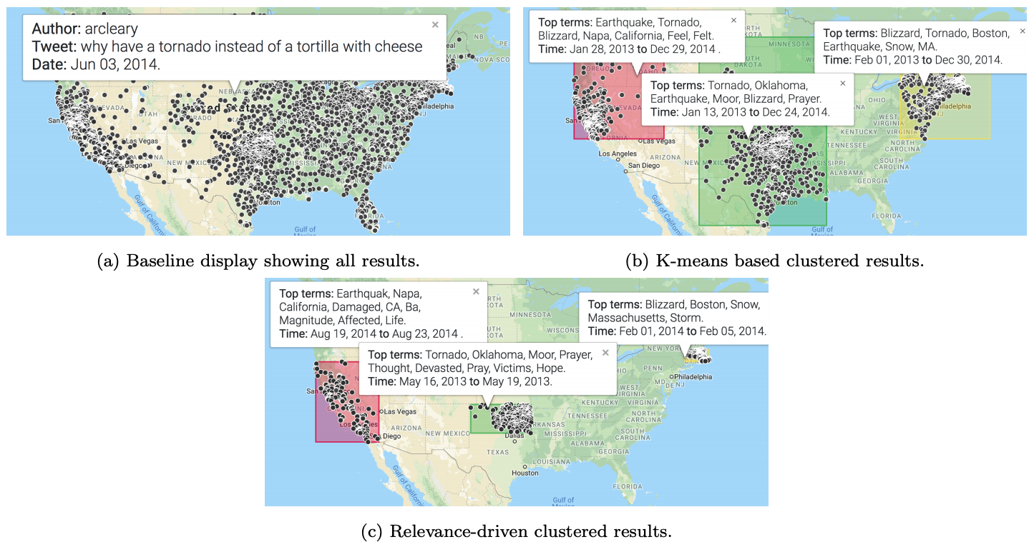
Why Relevance-driven Clustering?
We argue that it allows narrowing the clusters around core events.
Removes noisy elements that can be seen as irrelevant from an IR perspective.

Slide 8
Problem definition

Slide 9
Problem Definition
Given a query and its matching results, how to build the best clusters under different constrains?
All elements have probabilistic score of relevance.
P(q|d): probability that the document generates the query.
A cluster is defined by three constrains:
Time: defining time window of a cluster.
Position: defining a geo-located bounding box of a cluster.
Keyword: defining a set of keyword to include/exclude from a cluster.
Question: How to build the best clusters under constrains?
Clustering should take relevance score into account, but how?

Slide 10
Problem Definition: What metric?
What is a good cluster in this problem?
Good quality from IR respective – precision, recall and F1-score.
Hence we keep the eye on Expected F1-Score of a cluster.
Expected because we only have probability of relevance, not real labels.
What is the mathematic definition of EF1-Score?
What is the cluster that maximized Recall?
0
0
0
high recall (trivial solution) R=1.0
What is the cluster that maximized F1-Score?
1
0
1
high F1-score (non - trivial) F1=0.571
What is the cluster that maximized Precision?
0
1
0
high precision (trivial solution) P=1.0

Slide 11
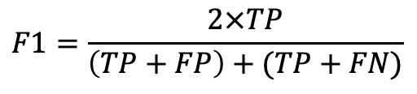
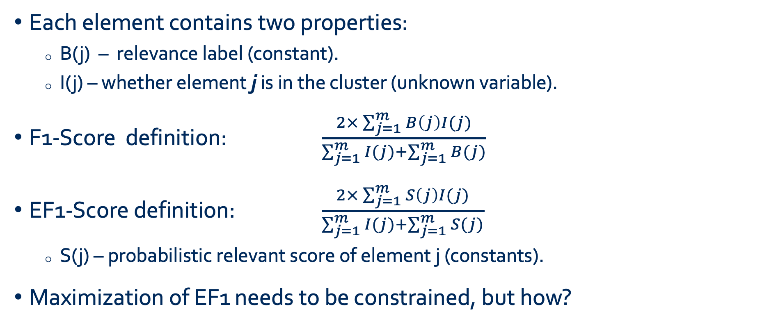
Problem Definition: Deriving Expected F1-Score
Recall:
Each element contains two properties:
B(j) – relevance label (constant).
I(j) – whether element j is in the cluster (unknown variable).
F1-Score definition: $\frac{2×\sum_{j=1}^{m}{B\left(j\right)I(j)}}{\sum_{j=1}^{m}{I(j)}+\sum_{j=1}^{m}{B(j)}}$
EF1-Score definition: $\frac{2×\sum_{j=1}^{m}{S\left(j\right)I(j)}}{\sum_{j=1}^{m}{I(j)}+\sum_{j=1}^{m}{S(j)}}$
S(j) – probabilistic relevant score of element j (constants).
Maximization of EF1 needs to be constrained, but how?
$$F1=\frac{2×TP}{\left(TP+FP\right)+(TP+FN)}$$
TP
No label at query time!
P=TP+FP
TP+FN
Explicit usage of relevance score!

Slide 12
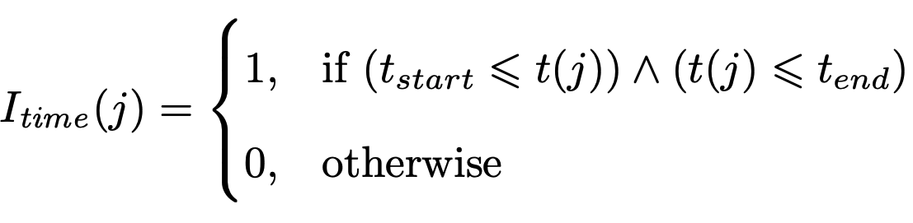
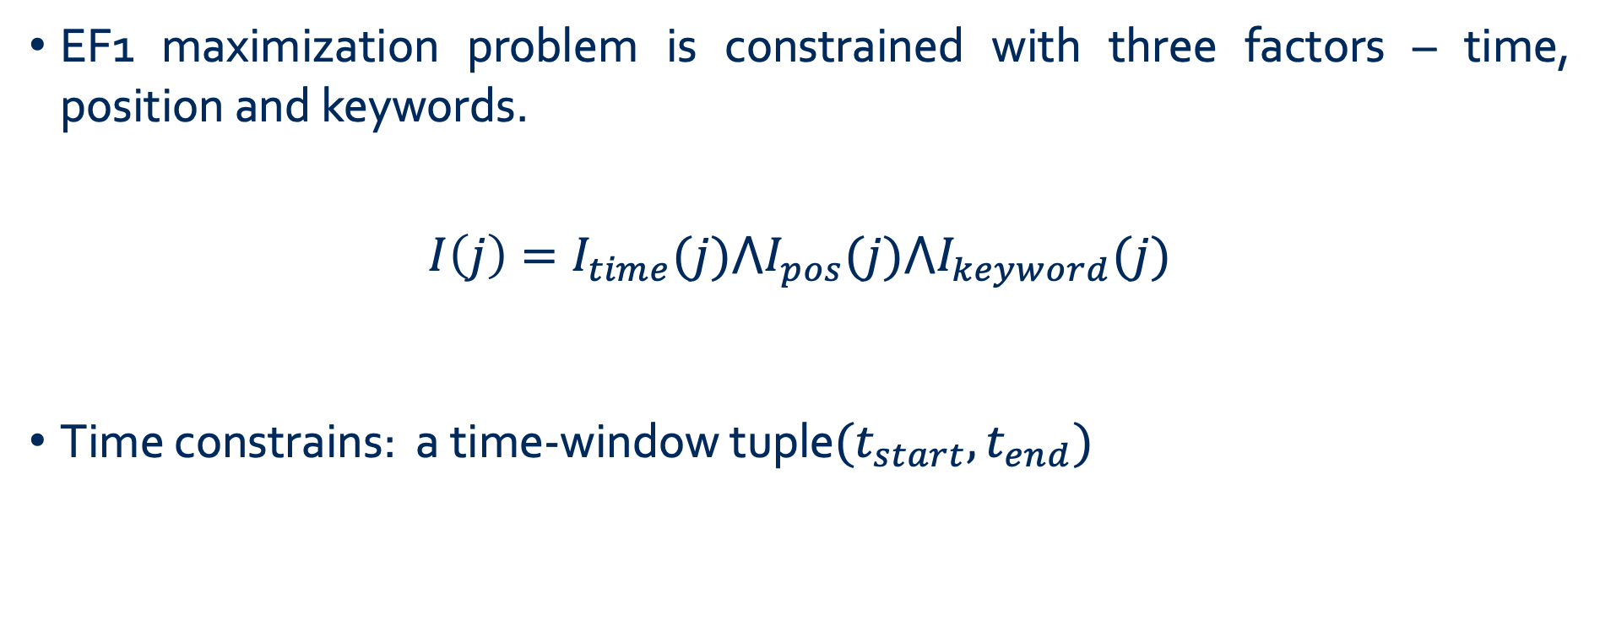
Problem Definition: Time Constraint
EF1 maximization problem is constrained with three factors – time, position and keywords.
$$I\left(j\right)=I_{time}(j)⋀I_{pos}(j)⋀I_{keyword}(j)$$
Time constrains: a time-window tuple$(t_{start},t_{end})$

Slide 13
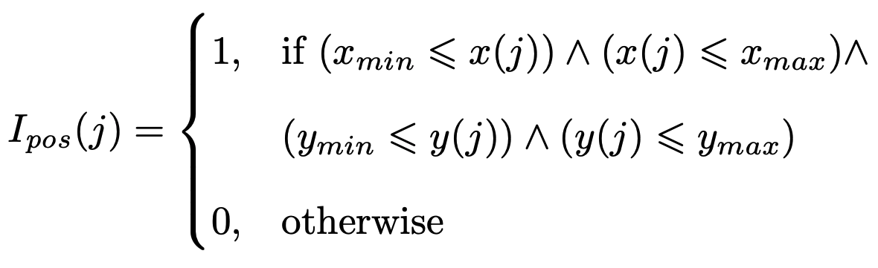
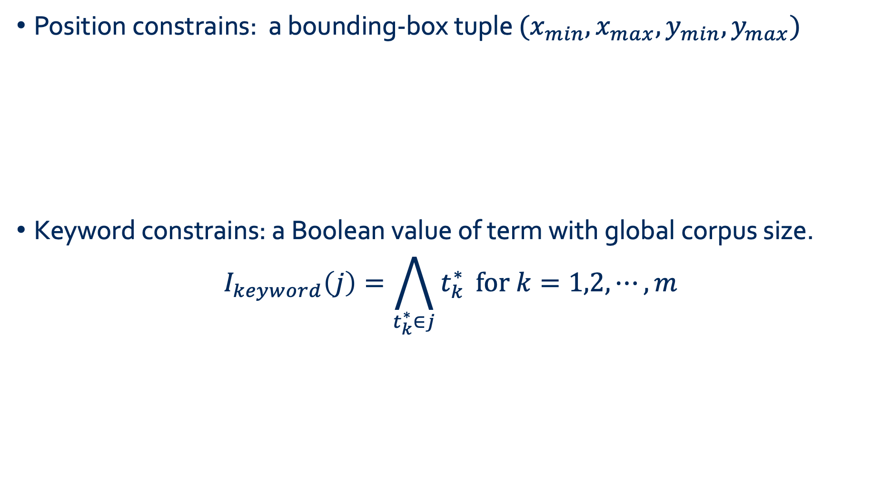
Problem Definition: Position and Keyword Constrains
Position constrains: a bounding-box tuple $(x_{min},x_{max},y_{min},y_{max})$
Keyword constrains: a Boolean value of term with global corpus size.
$$I_{keyword}\left(j\right)=\bigwedge_{t_{k}^{∗}∈j}{t_{k}^{∗}} \text{for} k=1,2,⋯,m$$

Slide 14
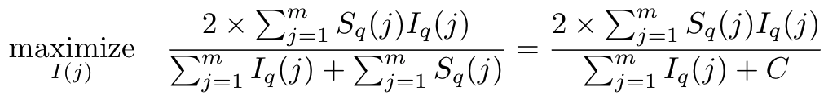
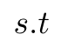
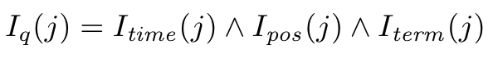
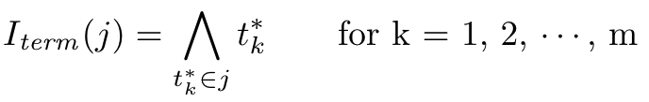
Problem definition: Formulation
Binary
Fractional MILP
Integer
Continuous

Slide 15
Solution Framework

Slide 16
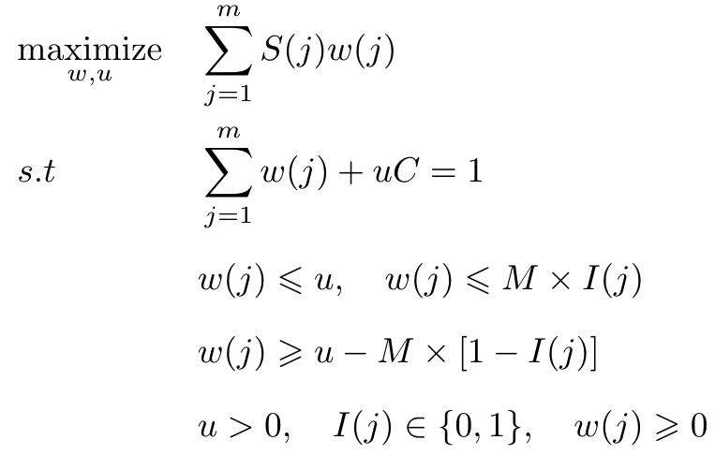
Solution Framework – MILP
Original EF1 definition: fractional MILP object (hard to solve).
Transform original fractional MILP into a pure MILP form: (Charnes-Cooper method and Glover linearization method).

Slide 17
Solution Framework
Our offline evaluation shows poor scalability of MILP method.
We developed a greedy algorithm to solve this EF1-optimization problem.
Very efficient (scalable).
Good approximation of the optimal solution (MILP).

Slide 18
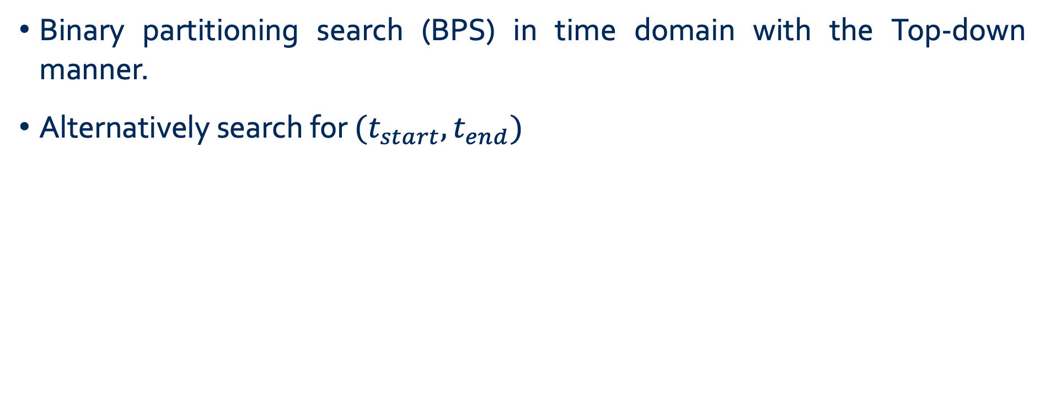
Solution Framework – Greedy Algorithm (time)
Binary partitioning search (BPS) in time domain with the Top-down manner.
Alternatively search for $(t_{start},t_{end})$
Fixing t_{start}
t_{end}
Time
e₈
e₁
Ef1`
e₅
e₇
e₃
e₄
e₂
Ef1

Slide 19
Solution Framework – Greedy Algorithm (time)
Binary partitioning search (BPS) in time domain with the Top-down manner.
Alternatively search for $(t_{start},t_{end})$
Fixing t_{end}
Time
e₈
e₁
e₅
e₇
e₃
Ef1`
e₄
e₂
Ef1
Ef1
t_{start}

Slide 20
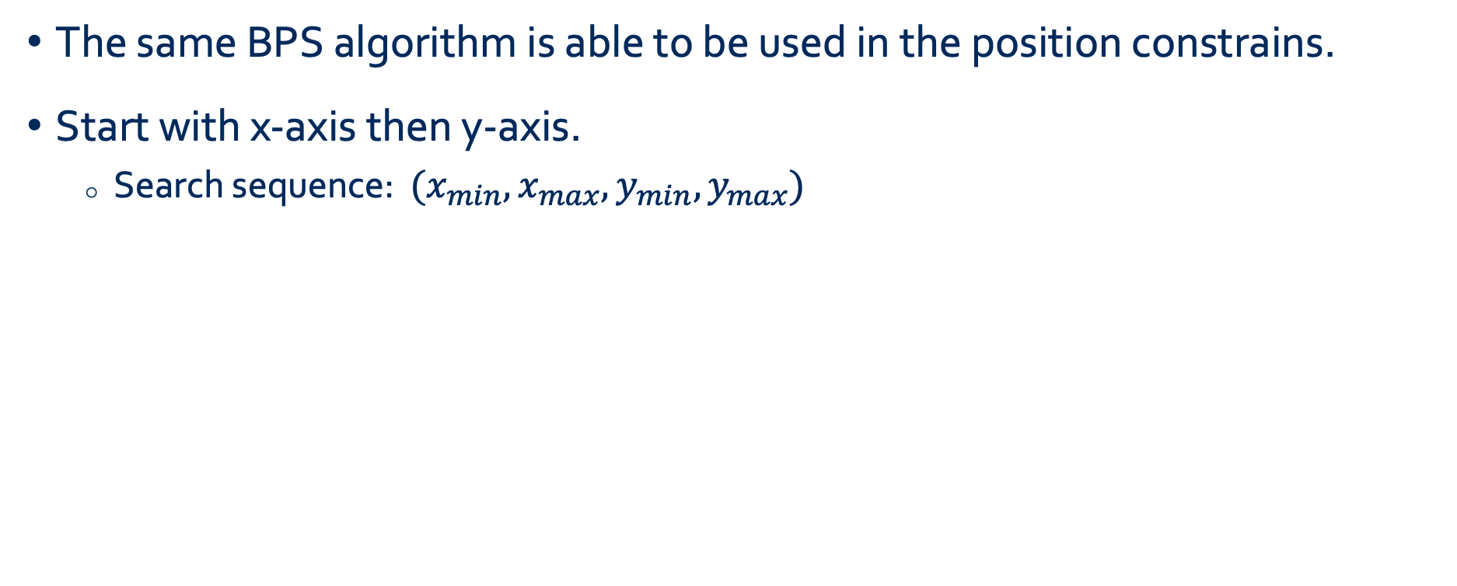
Solution Framework – Greedy Algorithm (Position)
The same BPS algorithm is able to be used in the position constrains.
Start with x-axis then y-axis.
Search sequence: $(x_{min},x_{max},y_{min},y_{max})$
y_{max}
X_{min}
y_{min}
X_{max}

Slide 21
Solution Framework – Greedy Algorithm (Keyword)
Greedily build keywords set with a Top-down manner until convergence of EF1.
keywords = {t1, t2, t3, …, tm}
Removing elements contains this term.
EF1⁽¹⁾
EF1⁽²⁾
EF1⁽³⁾
EF1^{(m)}

Slide 22
Solution Framework – Multiple Constrains
Previous method solves for the single natural constrain (time, or position, or keyword)… but how to handle multiple natural constrains?
Multiple constrains - based visual cluster:
greedily search with EF1 optimal among.
Time (t_{start} ,t_{end}): EF1^{(T)}
Position (x_{min}, x_{max}, y_{min}, y_{max}): EF1^{(P)}
keywords set: EF1^{(K)}
EF1^{(T)} VS EF1^{(P)} VS EF1^{(K)}

Slide 23
Solution Framework – Multiple Clusters
Previous algorithms work for a single cluster… but how to build the sequential clusters?
1. set elements score as zero
2. re-create the cluster

Slide 24
Offline Experiment

Slide 25
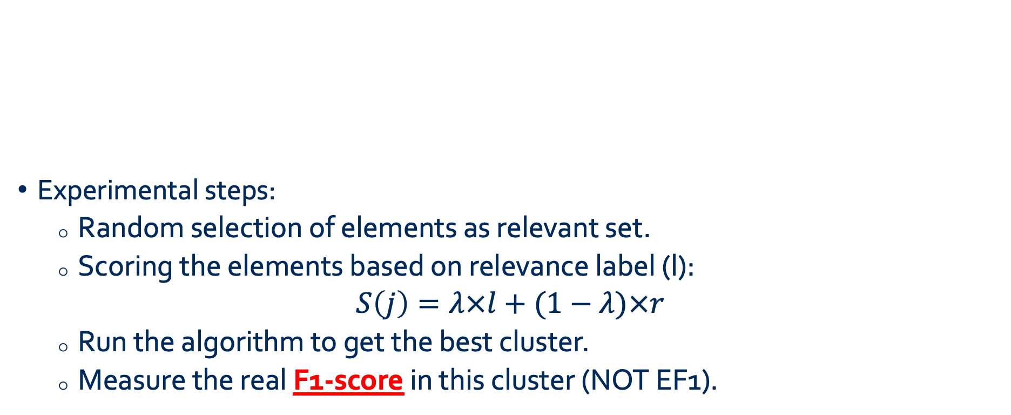
Offline Experiment
Experimental steps:
Random selection of elements as relevant set.
Scoring the elements based on relevance label (l):
$$S\left(j\right)=λ×l+(1−λ)×r$$
Run the algorithm to get the best cluster.
Measure the real F1-score in this cluster (NOT EF1).
r : random noisy
λ: noisy level
Small λ, high noisy

Slide 26
F1-Score performance: varying #data
Measuring different algorithms’ F1 performance with different size of data.
BPS algorithm reaches a good approximation of the optimal solution (MILP).

Slide 27
Time complexity: varying #data
Measuring different algorithms’ time with different size of data.
BPS method has the lowest time complexity.
MILP has exponential time complexity .
Lack of scalability in MILP method.

Slide 28
F1-Score performance: varying $λ$
Measuring different algorithms’ F1 performance with different λ.
BPS still reaches a good approximation of the optimal solution.

Slide 29
Time complexity : varying $λ$
Measuring different algorithms’ time with different λ (#data = 150).
MILP method has the highest time complexity (no scalability).

Slide 30
Online Experiment

Slide 31
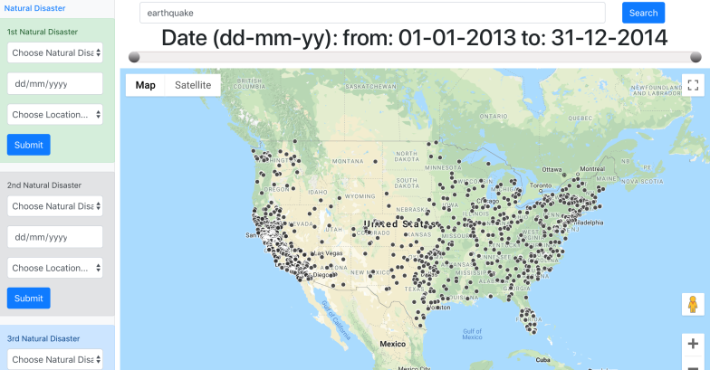
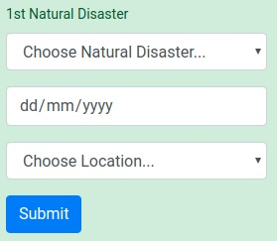
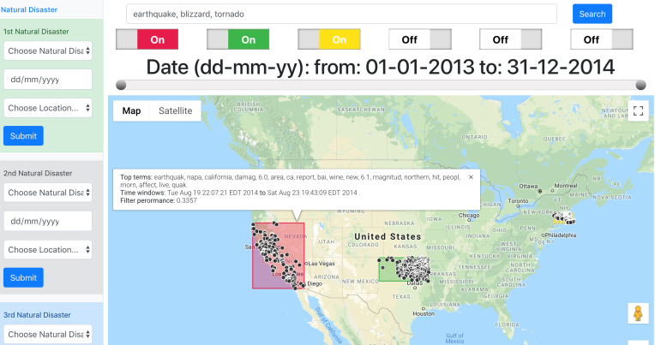
User Experiment – algorithms evaluation
Each user interacts with three different systems.
In each system, each user would query the system to achieve three search tasks.
User’s answers in each task: natural disaster type, time, and location.
Baseline system – No clustering
Clustering system – k-means & BPS

Slide 32
User Experimental results - Recall
BPS achieves the best performance of recall.
BPS costs much less time than the other algorithms.

Slide 33
Survey about users’ preference
Previous analysis is about users’ performance. How about their preference?
75% of users have highest preference in the BPS system

Slide 34
Conclusion

Slide 35
Conclusion
A novel relevance – driven clustering framework for interactive visual search.
Reformulating the EF1 optimization problem into MILP form.
Two greedy strategies to solve this optimization problem.
An offline evaluation of the algorithms.
BPS clustering achieves a good approximation of the optimal solution.
BPS greedy algorithms is very scalable and robust.
A user study with 24 participants.
Greedy-driven system (BPS) has the best performance.
75% of users have highest preference in the BPS system.

Slide 36
Thanks to my Collaborators !
Questions?
Scott Sanner
Yihao Du

